Slide 1
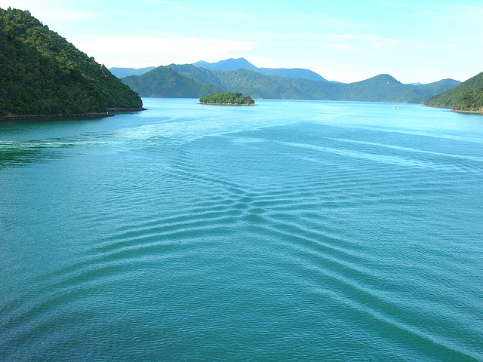
Wave INTERFERENCE
This lesson will introduce you to how wave interfere
You will also learn how to apply the principle of superposition to determine the exact shape of the wave form when waves interfere.

Slide 2

What are we going to cover today?
By the end of this lesson, you will be able to:
Explain wave interference
Apply the principle of superposition
Draw the result of the wave interference
Explain Standing Waves
Homework

Slide 3
TYPES OF WAVE INTERFERENCE
When two waves interact, certain changes in the amplitude of the wave take place. We call this wave interference
Interference is the result of two or more waves meeting each other at a particular point in space at the same time.

Slide 4
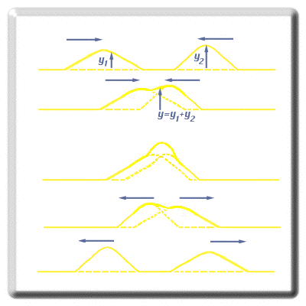
The principle of superposition
When two pulse come together, the total displacement is the sum of each individual pulse’s displacement

Slide 5
There are two types of interference
Constructive interference
Destructive interference

Slide 6
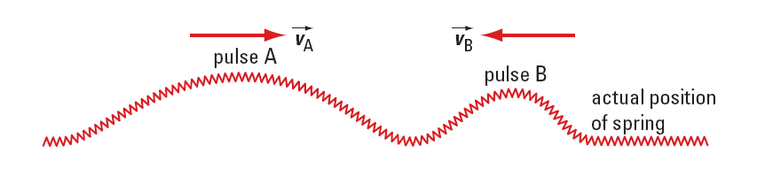
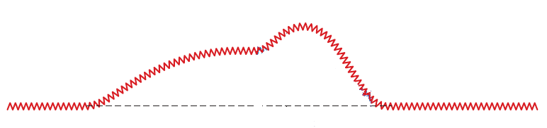
Constructive interference occurs when two crests or two troughs come together to produce a super-crest or a super-trough.

Slide 7
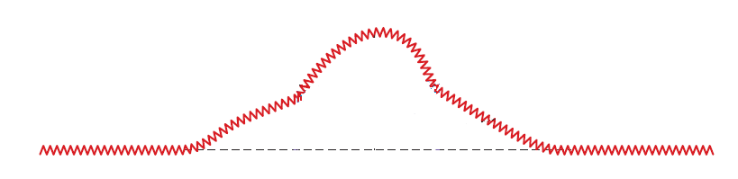
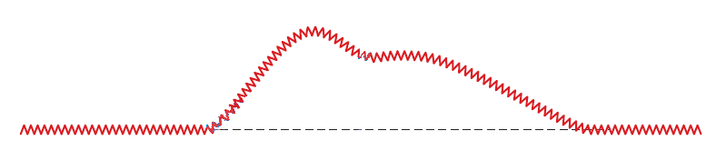
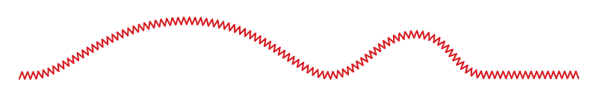
NOTE: A similar situation occurs when two troughs come together.

Slide 8
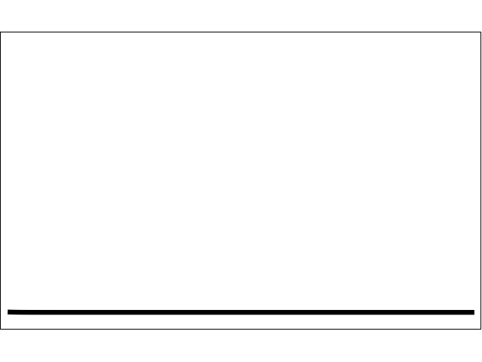

Slide 9
http://www.youtube.com/watch?v=YviTr5tH8jw

Slide 10
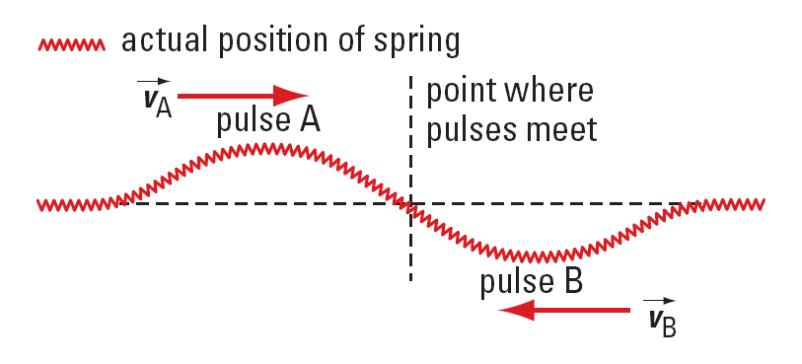
Destructive interference occurs when a crest meets a trough. The result is a momentary decrease in the amplitude of the wave. For a moment the sum of the displacements is zero, and no wave is seen.

Slide 11
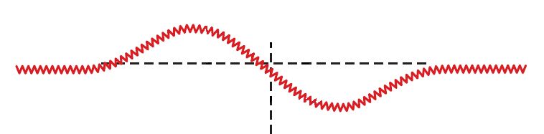
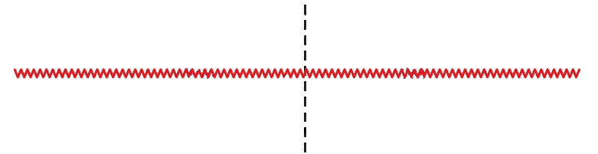
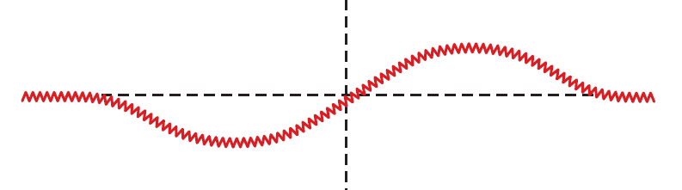

Slide 12
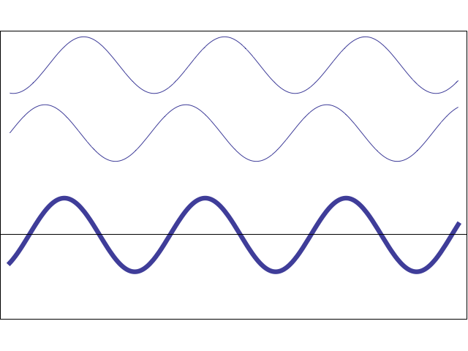

Slide 13
http://www.youtube.com/watch?v=IU8xeJlJ0mk

Slide 14
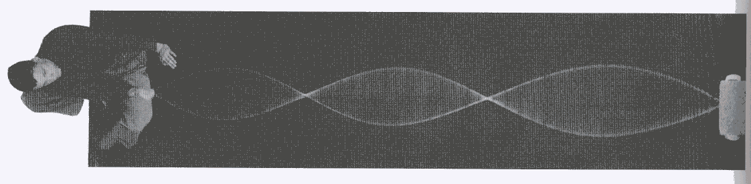
STANDING WAVES
A standing wave occurs when a particular wave reflects back on itself with the same frequency, wavelength, and speed.
In a standing wave, both constructive and destructive
interference occur. This results in areas of no vibration
and areas of maximum vibration

Slide 15
When crests from two waves or troughs come together in a medium, they are in phase
Produce constructive interference
When a crest from one wave comes meets a trough of another wave, they are out of phase
Produces destructive interference
As the waves pass through each other, they shift in and out of phase to produce a wave that seems to oscillate between points

Slide 16
NODES AND ANTINODES
Antinodes
Nodes

Slide 17
NODES AND ANTINODES
Nodes occur during phases of destructive interference
This happens every ½ λ
Between the nodes, the wave goes in a flip flop motion as waves switch from destructive to constructive interference
These are called antinodes and happen every ½ λ

Slide 18
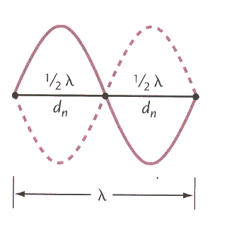
the distance between nodes, which is called the inter-nodal distance d_{n}, is equal to one-half the wavelength
If there are 3 nodal points, there are 2 inter-nodal distances

Slide 19
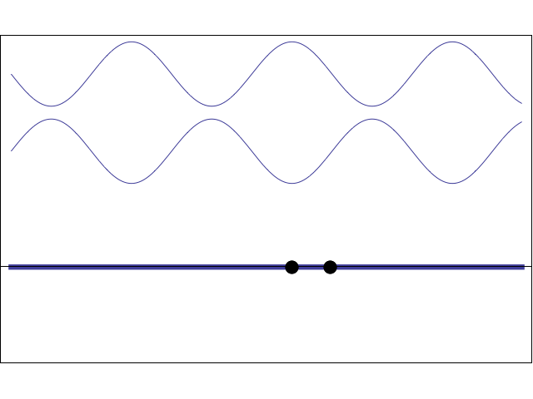

Slide 20
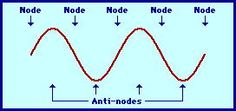

Slide 21
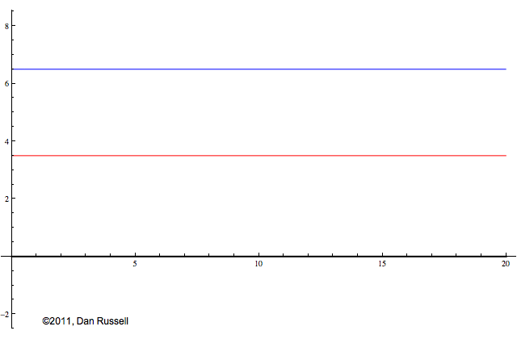
Notes:
blue: =
Red =
Black =

Slide 22
Standing waves

Slide 23
Ex 1: A standing wave has a distance of 45 cm between
four consecutive nodes. The frequency of the
source producing the standing wave is 30. Hz.
What is
a. the wavelength of the wave?
b. the speed of the wave?

Slide 24
MECHANICAL RESONANCE
Mechanical resonance is the vibrating response of an object to a periodic force from a source that has the same frequency as the natural frequency of the object
All objects have a natural frequency.
Take a swing as an example.
If you want the swing to go higher, you have to push
yourself at the right time in order to match your push freq with the natural freq of the swing.

Slide 25
If you match these two frequencies, the amplitude of vibration will start to increase.
So if a source is vibrating with the same freq as the natural freq of another object, it will cause the other object to vibrate with that freq

Slide 26
http://www.youtube.com/watch?v=j-zczJXSxnw
Notes:
HISTORY:
Watch the amazing "Gallopin' Gertie" November 7, 1940 film clip. 1940 Tacoma Narrows Bridge Slender, elegant and graceful, the Tacoma Narrows Bridge stretched like a steel ribbon across Puget Sound in 1940. The third longest suspension span in the world opened on July 1st. Only four months later, the great span's short life ended in disaster. "Galloping Gertie," collapsed in a windstorm on November 7,1940. The bridge became famous as "the most dramatic failure in bridge engineering history." Now, it's also "one of the world's largest man-made reefs." The sunken remains of Galloping Gertie were placed on the National Register of Historic Places in 1992 to protect her from salvagers. A dramatic tale of failure and success The story of the failure of the 1940 Narrows Bridge and the success of the Current Narrows Bridge is a great American saga. When Galloping Gertie splashed into Puget Sound, it created ripple effects across the nation and around the world. The event changed forever how engineers design suspension bridges. Gertie's failure led to the safer suspension spans we use today.

Slide 27
HOMEWORK
Read pgs 309 – 315
Questions 1 – 3 pg 312
1 – 3 pg 313
1 – 3 pg 315
1 – 3 pg 316
1 – 13 pg 317

